Slide 1
Induction and Recursion
Chapter 5

Slide 2
Mathematical Induction
Section 5.1

Slide 3
Video 44: Mathematical Induction
Principle of Mathematical Induction
Validity of Mathematical Induction

Slide 4
Principle of Mathematical Induction
Assume you would like to prove that a propositional function P(n) is true for all positive integers.
To prove this, you complete these steps:
Step 1: Show that P(1) is true (basis step)
Step 2: Assuming that P(k) holds for an arbitrary integer k (inductive hypothesis), show that P(k + 1) must be true (inductive step)
It seems perfectly reasonable to assume that then P(n) is true for all positive integers
This is the principle of mathematical induction

Slide 5
Example
Theorem: n < 2^{n} for all positive integers n.
Proof: Let P(n) be the proposition that n < 2^{n}.
BASIS STEP: P(1) is true since 1 < 2¹ = 2.
INDUCTIVE STEP: Assume P(k) holds, i.e., k < 2^{k}, for an arbitrary positive integer k.
Show that P(k + 1) holds.
Since by the inductive hypothesis, k < 2^{k}, it follows that:
k + 1 < 2^{k} + 1 ≤ 2^{k} + 2^{k} = 2 ∙ 2^{k} = 2^{k+1}
Therefore n < 2^{n} holds for all positive integers n. ◀︎

Slide 6
Mathematical Induction as Rule of Inference
Mathematical induction can be expressed as the rule of inference
(P(1) ∧ ∀k (P(k) → P(k + 1))) → ∀n P(n)
where the domain is the set of positive integers.
Basis Step: Show that P(1) is true
Inductive Step: Show that P(k) → P(k + 1) is true for all positive integers k.
Inference: ∀n P(n) is true

Slide 7
Two Important Points
In a proof by mathematical induction, we don’t assume that P(k) is true for all positive integers!
We rather show that if we assume that P(k) is true, then P(k + 1) must also be true.
Proofs by mathematical induction do not always start at the integer 1.
In such a case, the basis step begins at a starting point b where b is an integer.

Slide 8
Validity of Mathematical Induction
Mathematical induction is valid because of the well-ordering property (an axiom for the set of positive integers):
Every nonempty subset of the set of positive integers has a least element.
Mathematical induction is actually equivalent to the well-ordering property.

Slide 9
Correctness of Mathematical Induction
Suppose that P(1) is true and P(k) → P(k + 1) is true for all positive integers k.
Assume there is at least one positive integer n for which P(n) is false
Then the set S of positive integers for which P(n) is false is nonempty
By the well-ordering property, S has a least element, say m
m cannot be 1 since P(1) is true
Since m is positive and greater than 1, m − 1 must be a positive integer
Since m − 1 < m, it is not in S, so P(m − 1) must be true
But then, since P(k) → P(k + 1) for every positive integer k holds, P(m) must also be true
This contradicts P(m) being false
Hence, P(n) must be true for every positive integer n ◀︎

Slide 10
Summary
Mathematical Induction as a widely used proof method
It’s Validity derives from the well-ordering axiom of natural numbers

Slide 11
Video 45: Proofs by Mathematical Induction
Proofs of summation formulas
Inequalities
Divisibility Results
Number of Subsets

Slide 12
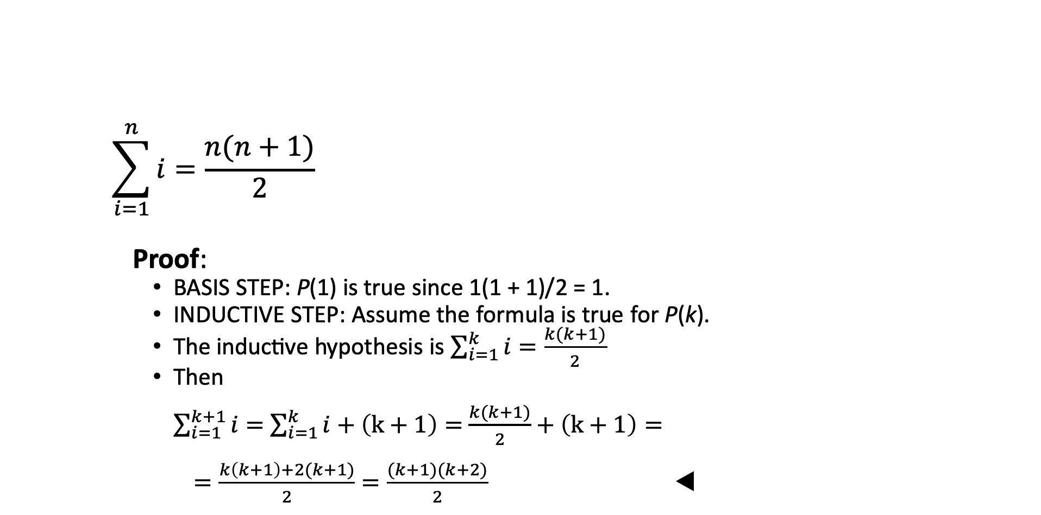
Summation Formulas
$$\sum_{i=1}^{n}{i}=\frac{n(n+1)}{2}$$
Proof:
BASIS STEP: P(1) is true since 1(1 + 1)/2 = 1.
INDUCTIVE STEP: Assume the formula is true for P(k).
The inductive hypothesis is $\sum_{i=1}^{k}{i}=\frac{k(k+1)}{2}$
Then $\sum_{i=1}^{k+1}{i}=$ $\sum_{i=1}^{k}{i}+\left(k+1\right)=$ $\frac{k(k+1)}{2}+\left(k+1\right)=$
$=\frac{k\left(k+1\right)+2(k+1)}{2}=\frac{(k+1)(k+2)}{2}$ ◀︎

Slide 13
Inequalities
Show that 2^{n} < n!, for every integer n ≥ 4.
Proof: Let P(n) be the proposition that 2^{n} < n!
BASIS STEP: P(4) is true since 2⁴ = 16 < 4! = 24.
INDUCTIVE STEP: Assume P(k) holds, i.e., 2^{k} < k! for an arbitrary integer k ≥ 4. Then:
2^{k+1} = 2 ∙ 2^{k}
< 2 ∙ k! (by the inductive hypothesis)
< (k + 1) k!
= (k + 1)!
Therefore, 2^{n} < n! holds, for every integer n ≥ 4. ◀︎
Note that here the basis step is P(4), since P(0), P(1), P(2), P(3) are all false.

Slide 14
Divisibility Results
Show that n³ − n is divisible by 3, for every positive integer n.
Proof: Let P(n) be the proposition that n³ − n is divisible by 3.
BASIS STEP: P(1) is true since 1³ − 1 = 0, which is divisible by 3.
INDUCTIVE STEP: Assume P(k) holds, i.e., k³ − k is divisible by 3, for an arbitrary positive integer k. Then:
(k + 1)³ − (k + 1) = (k³ + 3k² + 3k + 1) − (k + 1)
= (k³ − k) + 3(k² + k)
By the inductive hypothesis, the first term (k³ − k) is divisible by 3 and the second term is divisible by 3 since it is an integer multiplied by 3. The sum of two numbers divisible by 3 is divisible by 3.
Therefore, n³ − n is divisible by 3, for every integer positive integer n. ◀︎

Slide 15
Number of Subsets of a Finite Set
Theorem: If S is a finite set with n elements, where n is a nonnegative integer, then S has 2^{n} subsets.
Proof: Let P(n) be the proposition that a set with n elements has 2^{n} subsets.
BASIS STEP : P(0) is true, because the empty set has only itself as a subset and 2⁰ = 1.
INDUCTIVE STEP: Assume P(k) is true for an arbitrary nonnegative integer k.

Slide 16
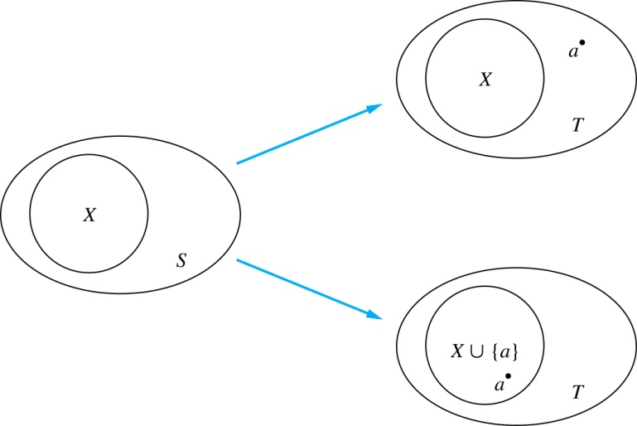
Number of Subsets – Inductive Step
Inductive Hypothesis: For an arbitrary nonnegative integer k, every set with k elements has 2^{k} subsets.
Let T be a set with k + 1 elements.
Then, for some a, T = S ∪ {a}, where a ∈ T and S = T − {a}
Hence |S| = k.
For each subset X of S, there are exactly two subsets of T, i.e., X and X ∪ {a}.
By the inductive hypothesis S has 2^{k} subsets.
Since there are two subsets of T for each subset of S, the number of subsets of T is 2 ∙2^{k} = 2^{k+1} .

Slide 17
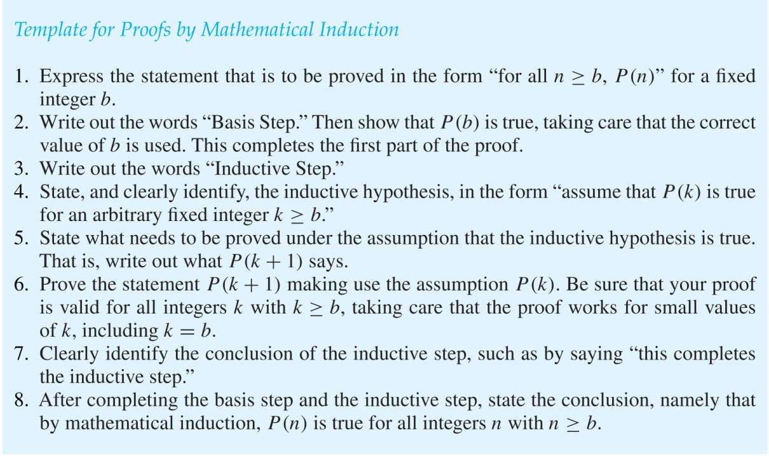
Mathematical Induction Proofs Guideline

Slide 18
Summary
Proofs of summation formulas
Inequalities
Divisibility Results
Number of Subsets

Slide 19
Strong Induction and Well-Ordering
Section 5.2

Slide 20
Video 46: Strong Induction
Principle of Strong Induction
Examples of Strong Induction

Slide 21
Strong Induction
To prove that P(n) is true for all positive integers n, where P(n) is a propositional function, complete two steps:
Basis Step: Show that P(1) is true
Inductive Step: Show that ∀k ([P(1) ∧ P(2) ∧∙∙∙ ∧ P(k)] → P(k + 1)) is true for all positive integers k.
Strong Induction is sometimes called the second principle of mathematical induction or complete induction.

Slide 22
Properties of Strong Induction
We can always use strong induction instead of mathematical induction.
But there is no reason to use it if it is simpler to use mathematical induction.
In fact, the principles of mathematical induction, strong induction, and the well-ordering property are all equivalent.
Sometimes it is clear how to proceed using one of the three methods, but not the other two.

Slide 23
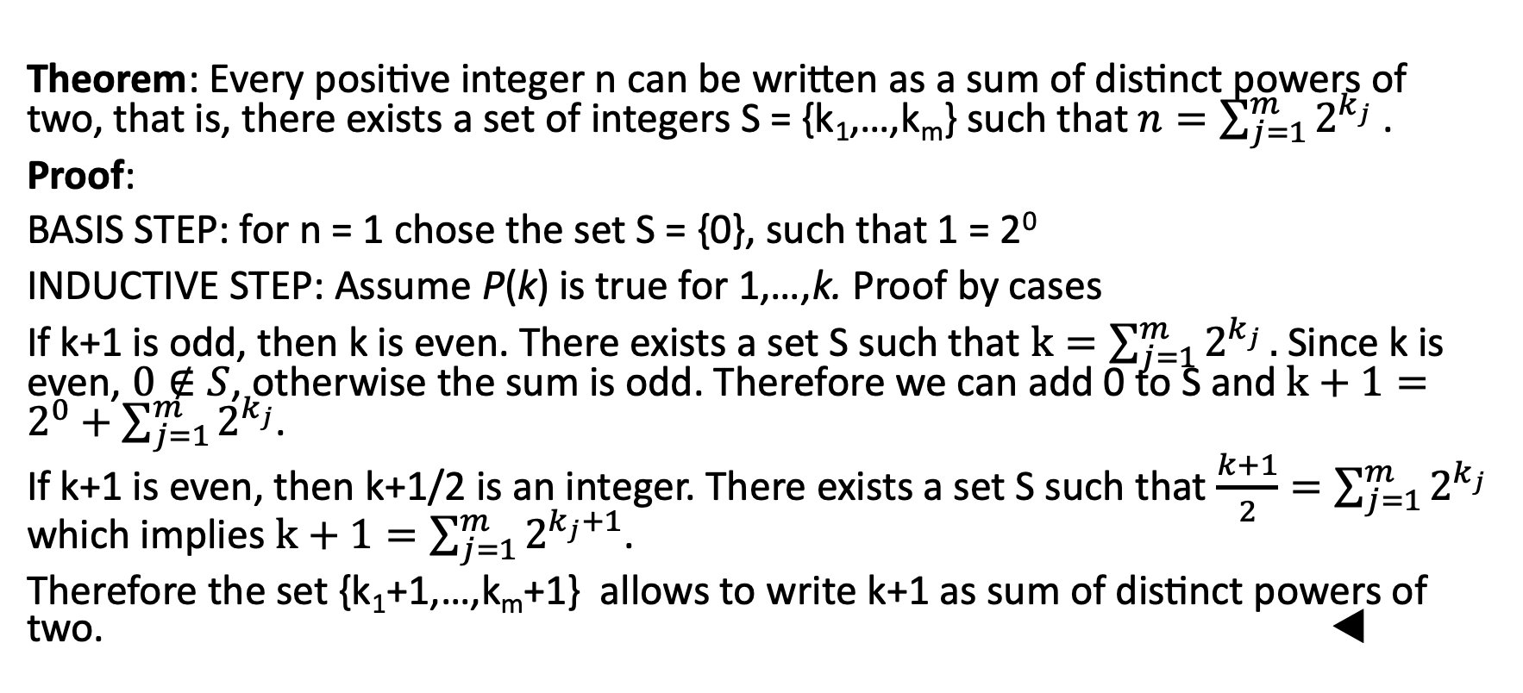
Example of Strong Induction
Theorem: Every positive integer n can be written as a sum of distinct powers of two, that is, there exists a set of integers S = {k₁,…,k_{m}} such that $n=\sum_{j=1}^{m}{2^{k_{j}}}$ .
Proof:
BASIS STEP: for n = 1 chose the set S = {0}, such that 1 = 2⁰
INDUCTIVE STEP: Assume P(k) is true for 1,…,k. Proof by cases
If k+1 is odd, then k is even. There exists a set S such that $k=\sum_{j=1}^{m}{2^{k_{j}}}.$Since k is even, $0∉S$, otherwise the sum is odd. Therefore we can add 0 to S and $k+1=2^{0}+\sum_{j=1}^{m}{2^{k_{j}}}$.
If k+1 is even, then k+1/2 is an integer. There exists a set S such that $\frac{k+1}{2}=\sum_{j=1}^{m}{2^{k_{j}}}$ which implies $k+1=\sum_{j=1}^{m}{2^{k_{j}+1}}$.
Therefore the set {k₁+1,…,k_{m}+1} allows to write k+1 as sum of distinct powers of two. ◀︎

Slide 24
Proof using Strong Induction
Prove that every amount of postage of 12 cents or more can be formed using just 4-cent and 5-cent stamps.
Proof: Let P(n) be the proposition that postage of n cents can be formed using 4-cent and 5-cent stamps.
BASIS STEP: P(12), P(13), P(14), and P(15) hold.
P(12) uses three 4-cent stamps.
P(13) uses two 4-cent stamps and one 5-cent stamp.
P(14) uses one 4-cent stamp and two 5-cent stamps.
P(15) uses three 5-cent stamps.
INDUCTIVE STEP: The inductive hypothesis states that P(j) holds for 12 ≤ j ≤ k, where k ≥ 15. Assuming the inductive hypothesis, it can be shown that P(k + 1) holds.
Using the inductive hypothesis, P(k − 3) holds since k − 3 ≥ 12. To form postage of k + 1 cents, add a 4-cent stamp to the postage for k − 3 cents.
Hence, P(n) holds for all n ≥ 12. ◀︎

Slide 25
Summary
Principle of Strong Induction
Proofs can be sometimes simpler with strong induction

Slide 26
Recursive Definitions and Structural Induction
Section 5.3

Slide 27
Video 47: Recursively Defined Functions
Recursively Defined Functions
Fibonacci Numbers

Slide 28
Recursively Defined Functions
Definition: A recursive or inductive definition of a function f nonegative integers as domain consists of two steps.
BASIS STEP: Specify the value of the function at zero.
RECURSIVE STEP: Give a rule for finding its value at an integer from its values at smaller integers.
A function f(n) is a sequence a₀, a₁, … , where f(i) = a_{i}.

Slide 29
Example
Suppose f is defined by
f(0) = 3,
f(n + 1) = 2 f(n) + 3
Then
f(1) = 2 ∙ f(0) + 3 = 2 ∙ 3 + 3 = 9
f(2) = 2 ∙ f(1)+ 3 = 2 ∙ 9 + 3 = 21
f(3) = 2 ∙ f(2) + 3 = 2 ∙ 21 + 3 = 45
f(4) = 2 ∙ f(3) + 3 = 2 ∙ 45 + 3 = 93

Slide 30
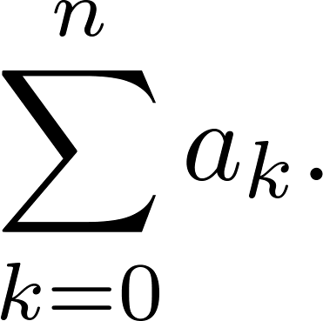
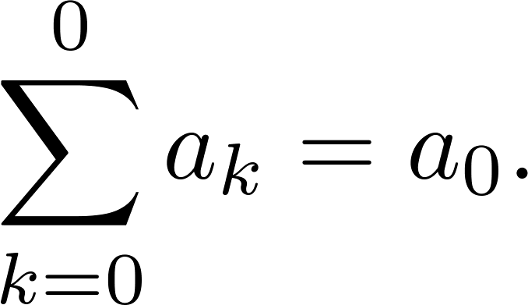
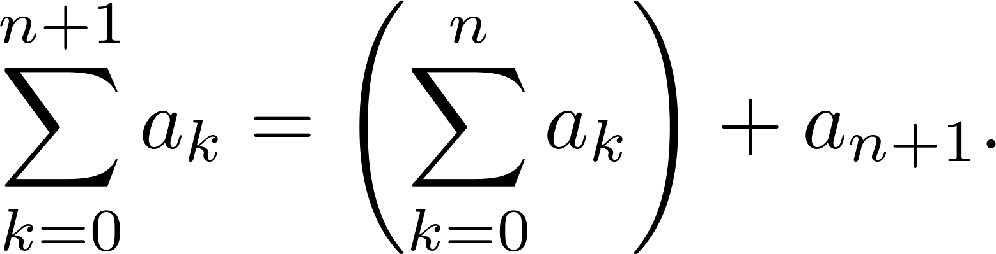
Example
Recursive definition of the factorial function n!
f(0) = 1
f(n + 1) = (n + 1) ∙ f(n)
Give a recursive definition of

Slide 31
Fibonacci Numbers
The Fibonacci numbers are defined as follows:
f₀ = 0
f₁ = 1
f_{n} = f_{n−1} + f_{n−2}
Then
f₂ = f₁ + f₀ = 1 + 0 = 1
f₃ = f₂ + f₁ = 1 + 1 = 2
f₄ = f₃ + f₂ = 2 + 1 = 3
f₅ = f₄ + f₃ = 3 + 2 = 5

Slide 32
Property of Fibonacci Numbers
Show that whenever n ≥ 3, f_{n} > α^{n − 2}, where α = (1 + √5)/2.
Proof: Let P(n) be the statement f_{n} > α^{n−2} .
We use strong induction to show that P(n) is true whenever n ≥ 3.
BASIS STEP: P(3) holds since α < 2 = f_{3,} P(4) holds since α² = (3 + √5)/2 < 3 = f₄ .
INDUCTIVE STEP: Assume that P(j) holds, i.e., f_{j} > α^{j−2} for all integers j with 3 ≤ j ≤ k, where k ≥ 4. Show that P(k + 1) holds, i.e., f_{k+1} > α^{k−1} .
Since α² = α + 1,
α^{k−1} = α² ∙ α^{k−3} = ( α + 1) ∙ α^{k−3} = α ∙ α^{k−3} + 1 ∙ α^{k−3} = α^{k−2} + α^{k−3}
By the inductive hypothesis, because k ≥ 4 we have
f_{k−1} > α^{k−3}, f_{k} > α^{k−2}.
Therefore, it follows that
f_{k+1} = f_{k} + f_{k−1} > α^{k−2} + α^{k−3} = α^{k−1}.
Hence, P(k + 1) is true.

Slide 33
Summary
Recursively Defined Functions
Fibonacci Numbers
Proving properties of Recursively Defined Functions using induction

Slide 34
Video 48: Recursively Defined Sets and Structures
Recursive definitions of sets
Natural Numbers and Strings
Recursively defined functions
Well-formed Formulae

Slide 35
Recursively Defined Sets and Structures
Recursion can be also used to define sets
Recursive definitions of sets have two parts:
The basis step specifies an initial collection of elements.
The recursive step gives the rules for forming new elements in the set from those already known to be in the set.
Only elements generated in the basis and recursive steps belong to the set (exclusion rule)

Slide 36
Examples
Recursive definition of the set of natural numbers N:
BASIS STEP: 0 ∊ N.
RECURSIVE STEP: If n is in N, then n + 1 is in N.
Initially 0 is in N, then 0 + 1 = 1, then 1 + 1 = 2, etc.
A subset of Integers S3:
BASIS STEP: 3 ∊ S3.
RECURSIVE STEP: If x ∊ S3 and y ∊ S3, then x + y is in S3.
Initially 3 is in S3, then 3 + 3 = 6, then 3 + 6 = 9, etc.

Slide 37
Strings
Definition: The set Σ* of strings over the alphabet Σ:
BASIS STEP: λ ∊ Σ* (λ is the empty string)
RECURSIVE STEP: If w is in Σ* and x is in Σ, then wx ∈ Σ*.
The alphabet Σ is a finite set, e.g.
Σ = {0, 1}
Σ = {a, b, …., z}

Slide 38
Examples
If Σ = {0, 1}, the strings in in Σ* are the set of all bit strings:
λ, 0, 1, 00, 01, 10, 11, …
If Σ = {a, b}, showing that aab is in Σ*:
Since λ ∊ Σ* and a ∊ Σ, a ∊ Σ*.
Since a ∊ Σ* and a ∊ Σ, aa ∊ Σ*.
Since aa ∊ Σ* and b ∊ Σ, aab ∊ Σ*.

Slide 39
Recursively defined functions on recursively defined sets
We can define functions by recursion on recursively defined sets
Example: Give a recursive definition of l(w), the length of the string w.
The length of a string can be recursively defined by:
l(λ) = 0
l(wx) = l(w) + 1 if w ∊ Σ* and x ∊ Σ

Slide 40
String Concatenation
Definition: The concatenation of two strings w₁ and w₂, denoted by w₁ ∙ w₂, is defined recursively as follows.
BASIS STEP: If w ∈ Σ*, then w ∙ λ= w.
RECURSIVE STEP: If w₁ ∈ Σ* and w₂ ∈ Σ* and x ∈ Σ, then w₁ ∙ (w₂ x) = (w₁ ∙ w₂)x.
Often w₁ ∙ w₂ is written as w₁ w₂.
Example: If w₁ = abra and w₂ = cadabra, the concatenation is w₁ w₂ = abracadabra.

Slide 41
Well-Formed Formulae in Propositional Logic
Definition: The set of well-formed formulae in propositional logic involving T, F, propositional variables, and operators from the set {¬, ∧, ∨, →, ↔} is recursively defined as
BASIS STEP: T, F and s, where s is a propositional variable, are well-formed formulae.
RECURSIVE STEP: If E and F are well formed formulae, then (¬ E), (E ∧ F), (E ∨ F), (E → F), (E ↔ F), are well-formed formulae.
Examples: ((p ∨ q) → (q ∧ F)) is a well-formed formula.
pq ∧ is not a well formed formula.
p ∧ q ∧ q is not a well formed formula.

Slide 42
Summary
Recursive definitions of sets
Natural Numbers and Strings
Recursively defined functions
Well-formed Formulae

Slide 43
Video 49: Structural Induction
Principle of structural induction
Examples

Slide 44
Structural Induction
To prove a property of the elements of a recursively defined set, we use structural induction.
BASIS STEP: Show that the result holds for all elements specified in the basis step of the recursive definition.
RECURSIVE STEP: Show that if the statement is true for each of the elements used to construct new elements in the recursive step of the definition, the result holds for these new elements.
The validity of structural induction can be shown to follow from the principle of mathematical induction.

Slide 45
Example
Theorem: l(xy) = l(x) + l(y), where x and y belong to Σ∗, the set of strings over the alphabet Σ.
Proof: Let P(y) be the statement that l(xy) = l(x) + l(y)
BASIS STEP: We show that P(𝜆) is true. We have that l(x𝜆) = l(x) + l(𝜆) for all x ∈ Σ, because l(x𝜆) = l(x) = l(x) + 0 = l(x) + l(𝜆) for x ∈ Σ∗
RECURSIVE STEP: We assume that P(y) is true and show that this implies that P(ya) is true whenever a ∈ Σ.
We need to show l(xya) = l(x) + l(ya) for every a ∈ Σ.
We have l(xya) = l(xy) + 1 and l(ya) = l(y) + 1 (definition of l).
Since the inductive hypothesis is l(xy) = l(x) + l(y) we conclude that l(xya) = l(x) + l(y) + 1 = l(x) + l(ya) ◀︎

Slide 46
Example
Theorem: Every well-formed formula for compound propositions contains an equal number of left and right parentheses.
Proof:
BASIS STEP: Each of the formula T, F, and s contains no parentheses, so they contain an equal number of left and right parentheses.
RECURSIVE STEP: Assume p and q are well-formed formulae, each containing an equal number of left and right parentheses.
For the two propositions p and q, let l_{p} and l_{q} be the number of left parenthesis and r_{p} and r_{q} the number of right parenthesis. The inductive hypothesis is that l_{p} = r_{p} and l_{q} = r_{q}
We need to show that each of (¬p), (p ∨ q), (p ∧ q), (p → q), and (p ↔ q) also contains an equal number of left and right parentheses.
The number of left parentheses in (¬p) equals l_{p} + 1 and the number of right parentheses r_{p} + 1.
For the other compound propositions the number of left parentheses equals l_{p} + l_{q} + 1 and the number of right parentheses equals r_{p} + r_{q} + 1
Since l_{p} = r_{p} and l_{q} = r_{q} in all cases the these compound expressions contains the same number of left and right parentheses.
This completes the proof by structural induction. ◀︎

Slide 47
Summary
Principle of structural induction
Structural induction on strings
Structural induction on well-formed formulae

Slide 48
Recursive Algorithms
Section 5.4

Slide 49
Video 50: Recursive Algorithms
Definition of recursive algorithms
Examples of recursive algorithms

Slide 50
Recursive Algorithms
Definition: An algorithm is called recursive if it solves a problem by reducing it to an instance of the same problem with smaller input.
For the algorithm to terminate, the instance of the problem must eventually be reduced to some initial case for which the solution is known.

Slide 51
Recursive Factorial Algorithm
A recursive algorithm for computing n!, where n is a nonnegative integer.
factorial(n) :=
if n = 0
then return 1
else return n ∙ factorial(n − 1)

Slide 52
Recursive Computation of Factorial
factorial(4) =
4*factorial(3) =
4*(3*factorial(2)) =
4*(3*(2*factorial(1))) =
4*(3*(2*(1*factorial(0)))) =
4*(3*(2*(1*1)))) =
4*(3*(2*1))) =
4*(3*2)) =
4*6 =
24

Slide 53
Recursive Exponentiation Algorithm
A recursive algorithm for computing a^{n}, where a is a nonzero real number and n is a nonnegative integer.
power(a, n) := if n <= 0 then return 1 else return a ∙ power(a, n-1)
This is a bad algorithm!

Slide 54
Recursive Computation of Exponentiation
power(a, 6) = a * power(a, 5) = a * (a * power(a, 4)) = a * (a * (a * power(a, 3))) = a * (a * (a * (a * power(a, 2)))) = a * (a * (a * (a * (a * power(a, 1))))) = a * (a * (a * (a * (a * (a* power(a, 0)))))) = a * (a * (a * (a * (a * (a* 1))))) = a * (a * (a * (a * (a * a)))) = a * (a * (a * (a * a²))) = a * (a * (a * a³)) = a * (a * a⁴) = a * a⁵ = a⁶

Slide 55
Better Recursive Exponentation
fast_power(a, n) := if n ≤ 0 then 1 else a^{n&1} · (fast_powerl(a, ⌊n/2⌋))²
⌊n/2⌋ is the Integer part of n/2
n&1 is 0 if n is even and 1 if n is odd

Slide 56
Recursive Computation of Power
fast_power(a, 6) =
a⁰ * fast_power(a, 3)² =
a⁰ * (a¹ * fast_power(a, 1)²)² =
a⁰ * (a¹ * (a¹ * fast_power(a, 0)²)²)² =
a⁰ * (a¹ * (a)²)² =
a⁰ * (a³)² =
a⁶

Slide 57
Recursive Linear Search
procedure recursive_linear_search(i, j, x: integers, 1 ≤ i ≤ j ≤ n)
if a_{i} = x then return i
else if i = j then return 0
else return recursive_linear_search(i + 1, j, x)
procedure linear search(x: integer, a₁, a₂, …,a_{n}: distinct integers)
i := 1
while (i ≤ n and x ≠ a_{i})
i := i + 1
if i ≤ n then location := i else location := 0
return location

Slide 58
Recursive Binary Search Algorithm
Assume we have a₁, a₂, …, a_{n}, an increasing sequence of integers.
Initially i is 1 and j is n. We are searching for x.
recursive_binary_search(i, j, x ) :=
m := ⌊(i + j)/2⌋
if x = a_{m} then return m
else if (x < a_{m} and i < m) then return recursive_binary_search(i, m−1, x)
else if (x > a_{m} and j > m) then return recursive_binary_search(m+1, j, x)
else return 0

Slide 59
Summary
Recursive algorithms for
Factorial function
Exponentation
Search

Slide 60
Video 51: Recursion, Induction and Iteration
Recursion and induction
Recursion and iteration

Slide 61
Recursion and Induction
Induction and recursion are different approaches to proving results and solving problems
They have in common that they both in the first place rely on the ability to achieve the desired result for the smallest possible version of the problem at hand
Induction extends this ability to problems of any size
Recursion reduces a problem of any size to the smallest possible ones
Induction can be used to prove correctness of recursive algorithms

Slide 62
Proving Recursive Algorithms Correct
Prove that the algorithm for computing the powers of real numbers is correct
power(a, n) := if n <= 0 then return 1 else return a ∙ power(a, n-1)
Proof: Use mathematical induction on the exponent n.
BASIS STEP: a⁰ = 1 for every nonzero real number a, and power(a, 0) = 1.
INDUCTIVE STEP: The inductive hypothesis is that power(a, k) = a^{k}, for all a ≠0. Assuming the inductive hypothesis, the algorithm correctly computes a^{k+1}, since
power(a,k + 1) = a∙ power (a, k) = a∙ a^{k} = a^{k+1} ◀︎

Slide 63
Recursion and Iteration
A recursively defined function can be evaluated in two different ways
Recursively: for a value apply directly the recursive definition, till a base case is reached, a recursive algorithm
Iteratively: start with base cases, and apply the recursive definition to compute the function for larger values

Slide 64
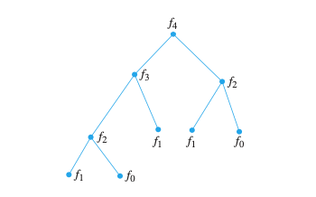
Fibonacci Function
fibonacci(n) :=
if n ≤ 1 then return n
else return fibonacci(n-1) + fibonacci(n-2)
Note that f₂ is computed multiple times
Blindy using recursion can be inefficient!

Slide 65
Iterative Algorithm
iterative_fibonacci(n) :=
if n = 0 then return 0
else
previous := 0
current := 1
for i = 1 to n - 1
next := previous + current
previous := current
current := next
return current
Complexity is Θ(n)

Slide 66
Iterative computation
iterative_fibonacci(4)
previous = 0, current = 1
i = 1: next = 1, previous = 1, current = 1
i = 2: next = 2, previous = 1, current = 2
i = 3: next = 3, previous = 2, current = 3
Keep memory of last two Fibonacci numbers

Slide 67
Summary
Proving correctness of recursive algorithms using induction
Iterative algorithm for Fibonacci numbers

Slide 68
Video 52: Recursive Sorting
Merge Sort
Complexity of Merge Sort

Slide 69
Recursive Sorting
Sorting algorithms, like Bubble Sort, had complexity Θ(n²)
Merge Sort is a recursive sorting algorithm that performs significantly better
Merge Sort works by iteratively splitting a list into two sublists of equal length until each sublist has one element.
At each step a pair of sublists is successively merged into a list with the elements in increasing order. The process ends when all the sublists have been merged.

Slide 70
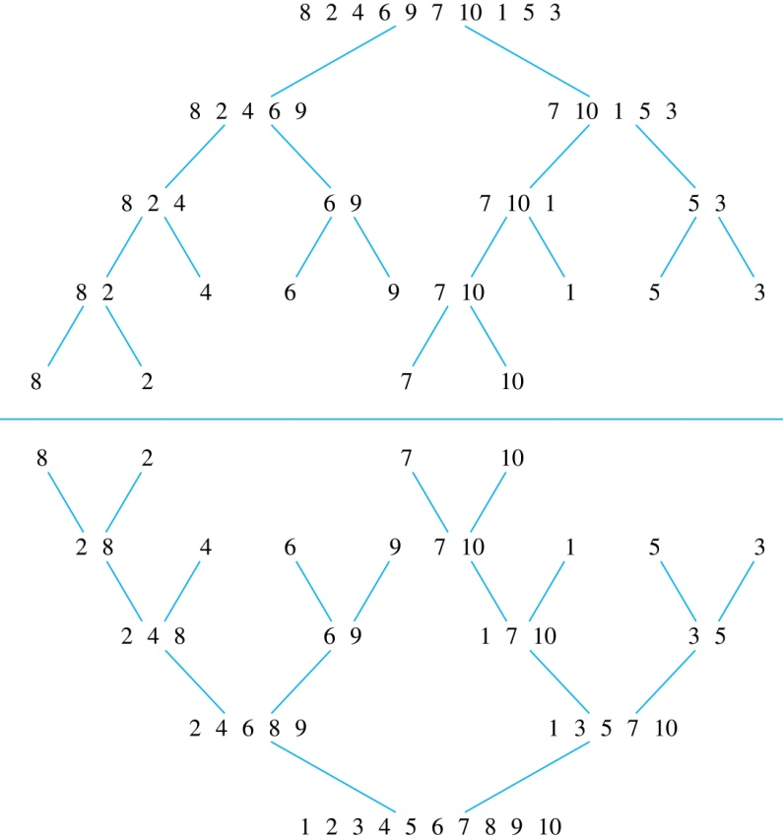
Illustration Merge Sort
List to be sorted
Splitting into two sublists
Splitting the sublist into sublists
Splitting the sublists into sublists
All list of length 1
Merging the lists in the right order
Merging the merged lists in the right order
Merging the merged lists in the right order
Merging 2 lists in the right order
Resulting ist is sorted

Slide 71
Illustration Merging Two Lists
Example: merging the two sorted lists
Traverse the two lists in parallel from left to right
2 4 6 8 9 1 3 5 7 10
1 2 3 4 5 6 7 8 9 10
Always take the smaller element at the left of the two lists

Slide 72
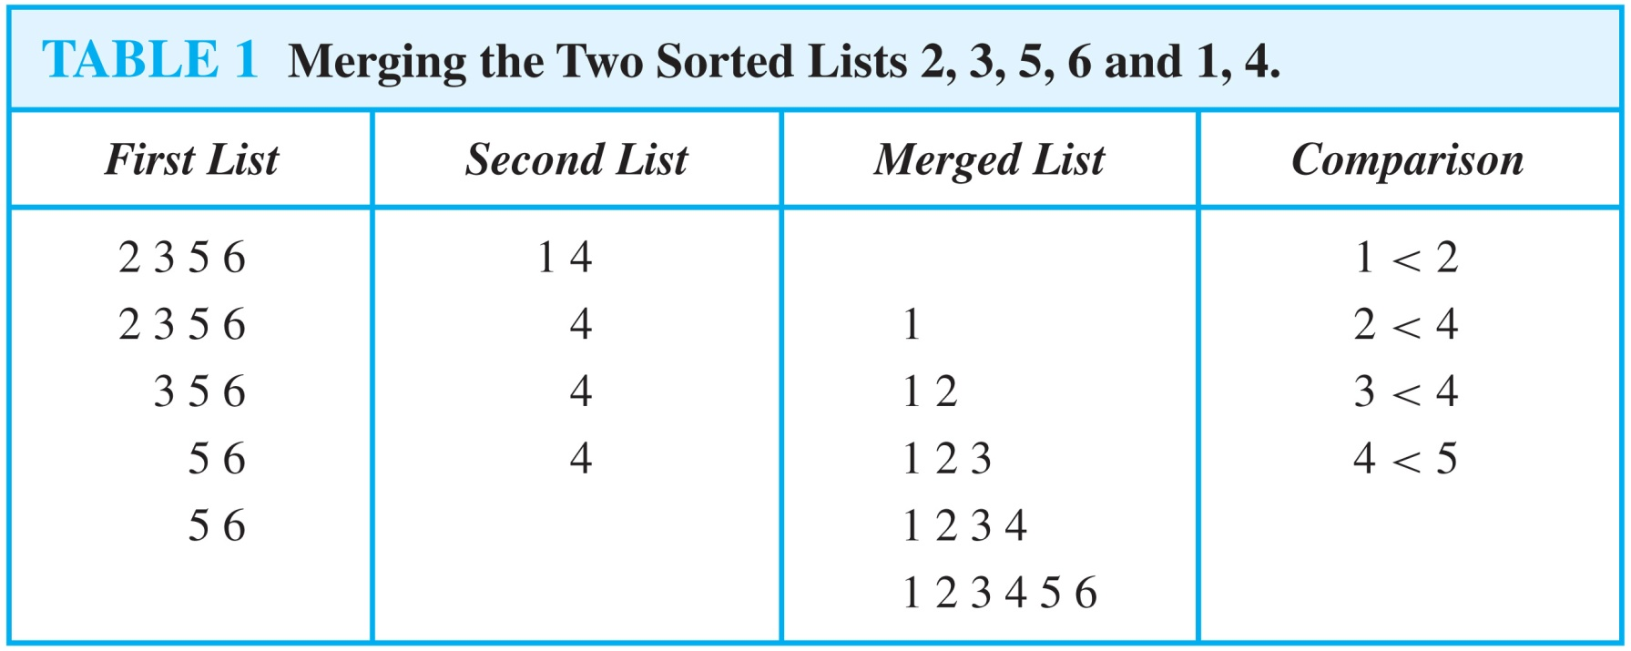
Comparisons for Mergin Two Lists
Example: Merge the two lists 2, 3, 5, 6 and 1, 4.

Slide 73
Algorithm for Merging Two Sorted lists
Complexity of Merge: at most |L₁| + |L₂| - 1 comparisons
procedure merge(L₁, L₂ : sorted lists)
L := empty list
while L₁ and L₂ are both nonempty
remove smaller of first elements of L₁ and L₂ from its list;
put it at the end of L
if this removal makes one list empty
then remove all elements from the other list and append them to L
return L

Slide 74
Recursive Merge Sort
When mergesort terminates L is sorted into elements in increasing order
procedure mergesort(L = a₁, a₂, …, a_{n} )
if n > 1 then
m := ⌊n/2⌋
L₁ := a₁, a₂, …, a_{m}
L₂ := a_{m+1}, a_{m+2}, …, a_{n}
L := merge(mergesort(L₁), mergesort(L₂ ))

Slide 75
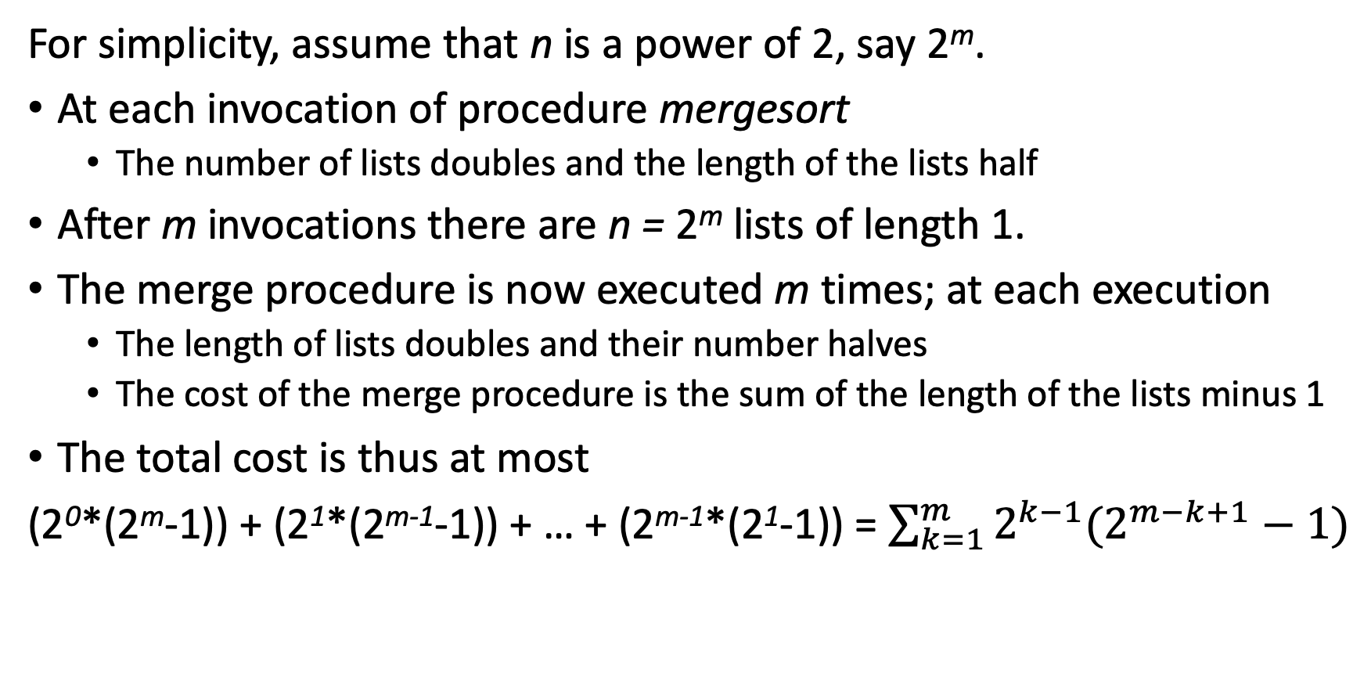
Complexity of Merge Sort
For simplicity, assume that n is a power of 2, say 2^{m}.
At each invocation of procedure mergesort
The number of lists doubles and the length of the lists half
After m invocations there are n = 2^{m} lists of length 1.
The merge procedure is now executed m times; at each execution
The length of lists doubles and their number halves
The cost of the merge procedure is the sum of the length of the lists minus 1
The total cost is thus at most
(2⁰*(2^{m}-1)) + (2¹*(2^{m-1}-1)) + … + (2^{m-1}*(2¹-1)) = $\sum_{k=1}^{m}{2^{k−1}(2^{m−k+1}−1)}$
Number of merges
Cost of merge

Slide 76
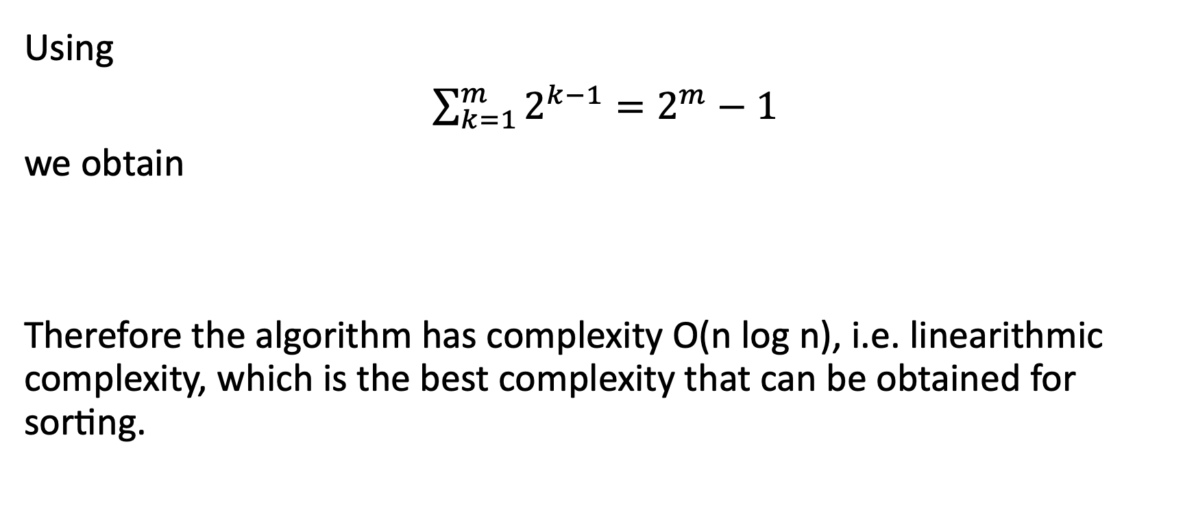
Complexity of Merge Sort
Using
$\sum_{k=1}^{m}{2^{k−1}=2^{m}−1}$
we obtain
Therefore the algorithm has complexity O(n log n), i.e. linearithmic complexity, which is the best complexity that can be obtained for sorting.

Slide 77
Summary
Merge Sort is a recursive sorting algorithm
Complexity of Merge Sort is linearithmic

